Slide 1
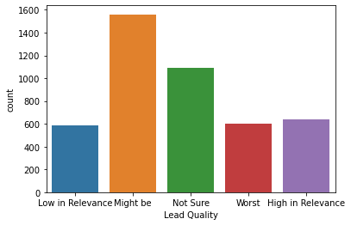
Lead Quality
Might be and Not sure have highest counts
Rest of the counts are lower than average

Slide 2
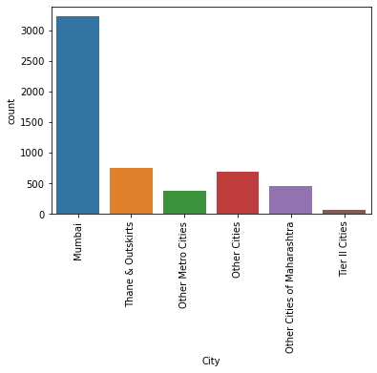
Lead Cities
Mumbai provides maximum data
Rest of the cities are lower than average

Slide 3
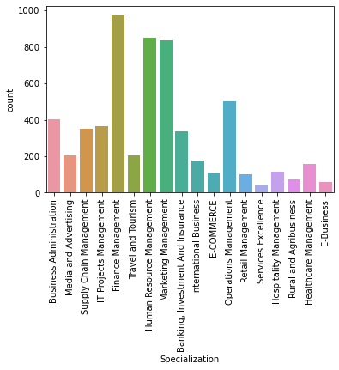
Lead Courses
Finance, HR, Marketing & Operations have highest counts
No directional inputs

Slide 4
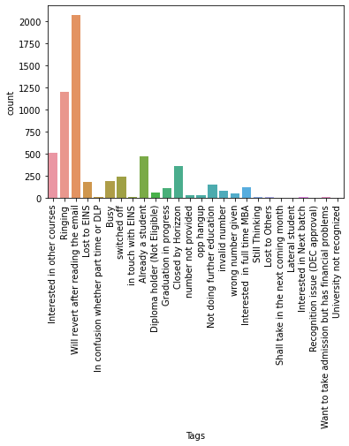
Lead Outcomes
Ringing and Revert after reading email have highest outcomes
No directional input

Slide 5
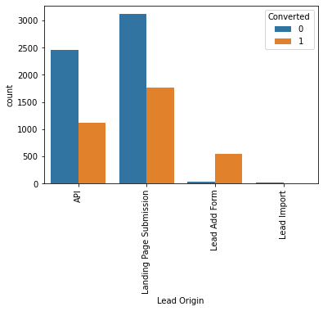
Lead Conversion
Landing page submission and API generated maximum conversions

Slide 6
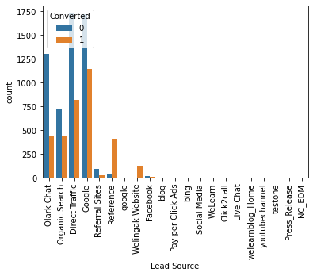
Lead Source
Google and Direct Traffic generate most conversion

Slide 7
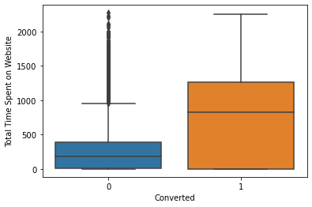
Lead Time spent
Leads spending more time have better conversion rate Website could provide more information to help leads better Generic Survey could help understand requirements for leads on Website

Slide 8
Lead Outcomes
Ringing and Revert after reading email have highest outcomes
No directional input

Slide 9
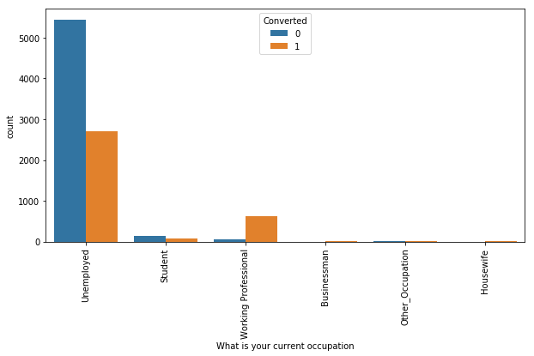
Lead Occupation
Working Professionals going for the course have high chances of joining it.
Unemployed leads are the most in numbers but has around 30-35% conversion rate.

Slide 10
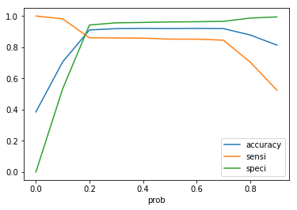
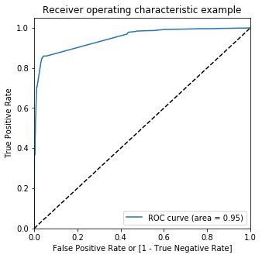
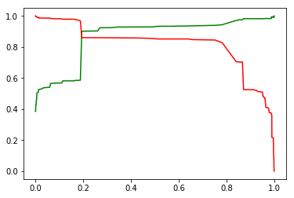
Model Outcome on Test Data

Slide 11
Model Outcome on predicted
Overall Accuracy 89%
Sensitivity – 82%
Specificity – 92%

Slide 12
Overall Observations
API and Landing page Submission has highest leads
Lead Add Form has highest conversion
conversion for API and Landing page is about 30%
Direct Traffic and Google generate Maximum Leads
Most of the customers are self reliant in chossing courses based on Google and Direct Traffic
Olark, Organic Search, Referral Sites and Welingak website could generate more leads, resulting in better success rate
Leads spending more time have better conversion rate
Website could provide more information to help leads better
Generic Survery could help understand requirements for leads on Website
SMS sent, Email Opened, Chat Conversion have good leads and conversion
SMS Sent and email opened has highest conversion
other communication and information options should be more informative
Other Specialization has most leads, directing towards no solid plan for future
These customer might not need specialization but market overview about what they are interested in

